Slide 1
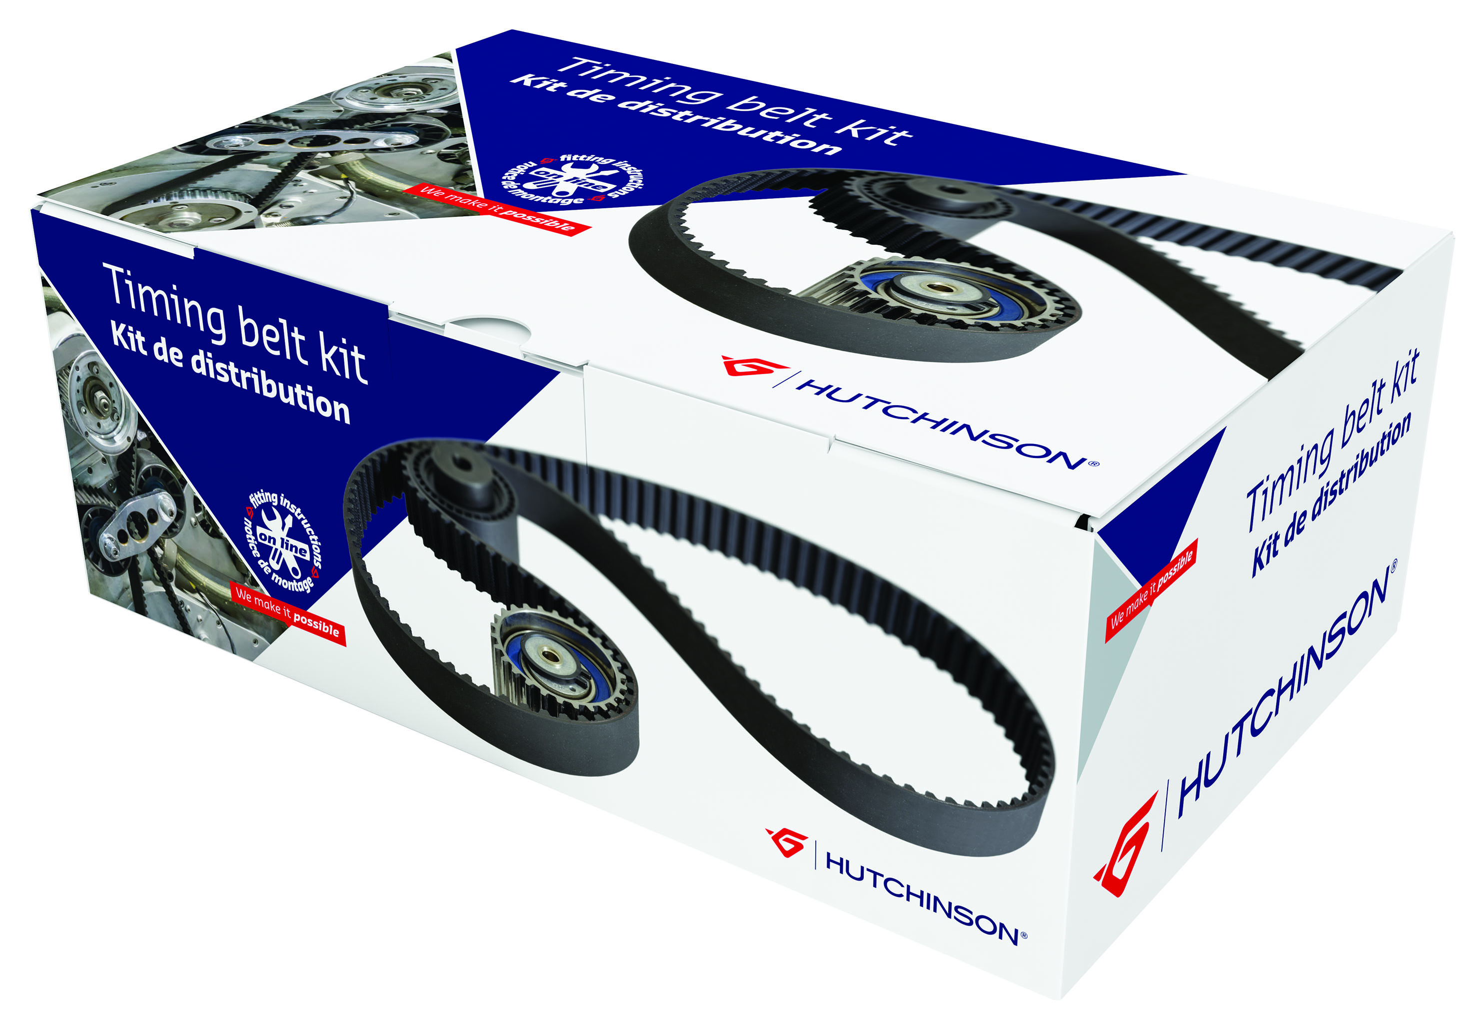
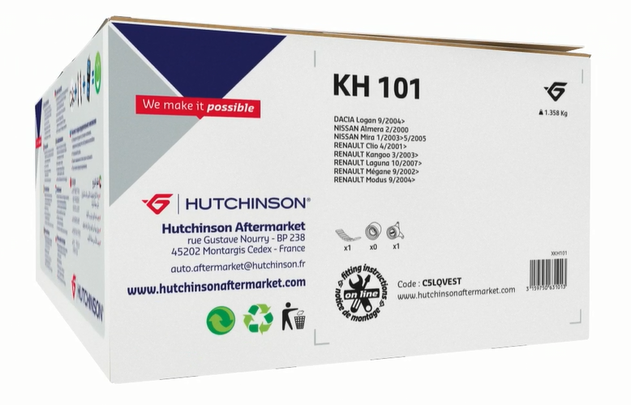
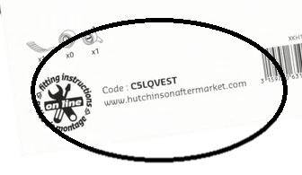

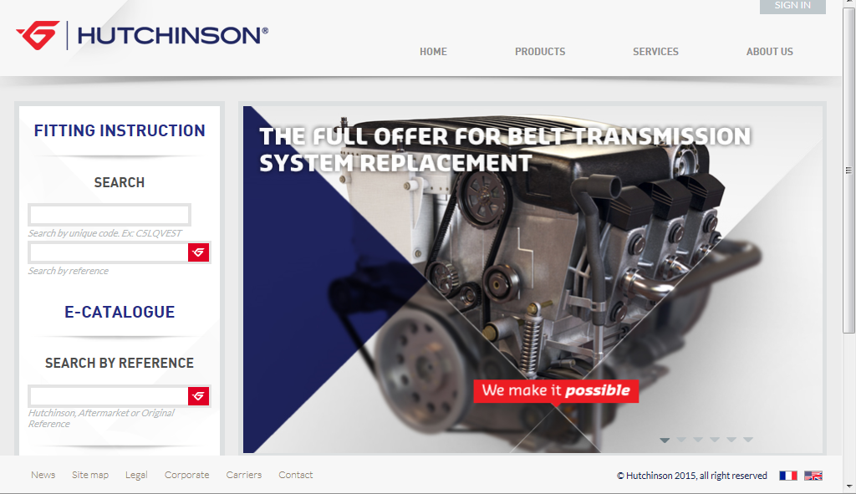
ONLINE INSTRUCTION
How to get it
Since the beginning of 2015, HUTCHINSON allows you to download online fitting instruction for free..
To get your fitting instruction :
1/ Keep the HUTCHINSON reference and the unique code you will find on the box label
2/ Connect to our website www.hutchinsonaftermarket.com
3/ On the left side, in « FITTING INSTRUCTION », enter :
- the code
- the reference

Slide 2
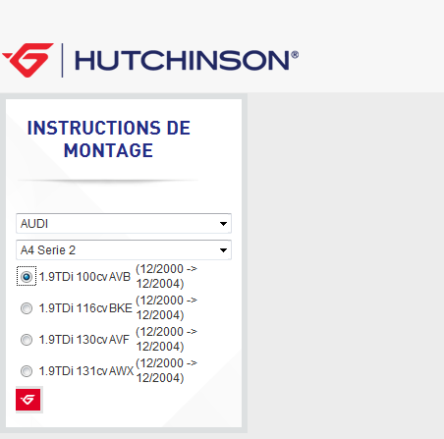
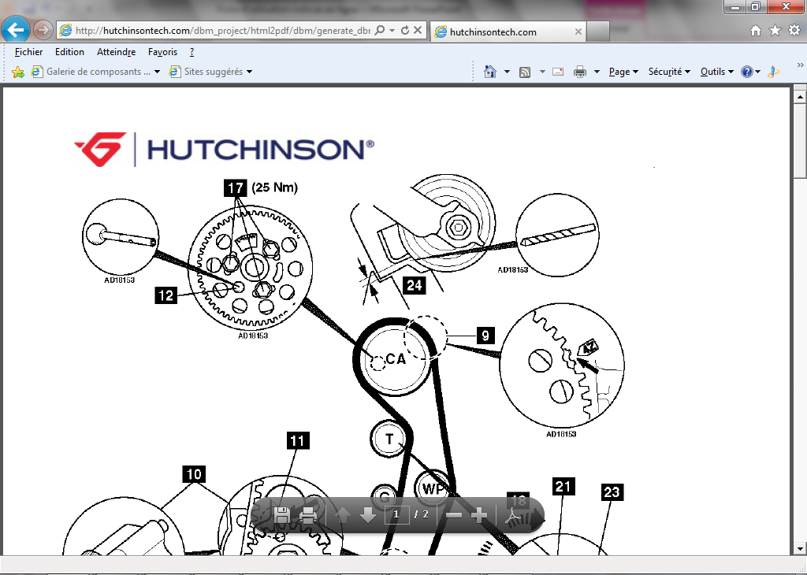
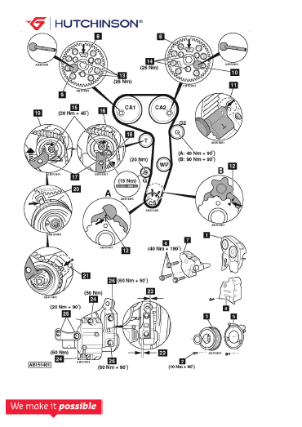
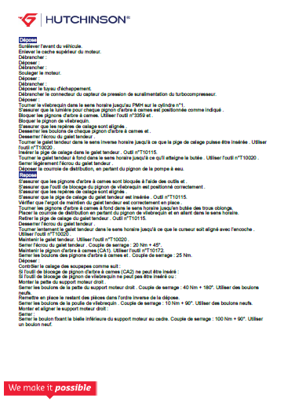
4/ Select the brand, the model, and your engine
5/ The instruction is generated, you can print it or save it !
Scheme
Fitting instruction

